Slide 1
Morse Code Practice Kit
200650U - Lasitha Jananjaya

Slide 2
General Info
This device can be used for decoding and coding Morse code.
Code sending process
ASCII code input is received by the module, converted into Morse code, and then converted into audio signal.
Code receiving process
It converts the received audio signal into Morse code, and then convert it into ASCII code and displays it.

Slide 3
Simulation
Done using WOKWI – Online simulator
designs
Altium Designer and Solidworks
Manufacturing
JLCPCB and 3D Printing
Assembly
Hand soldered and Assembled by myself

Slide 4
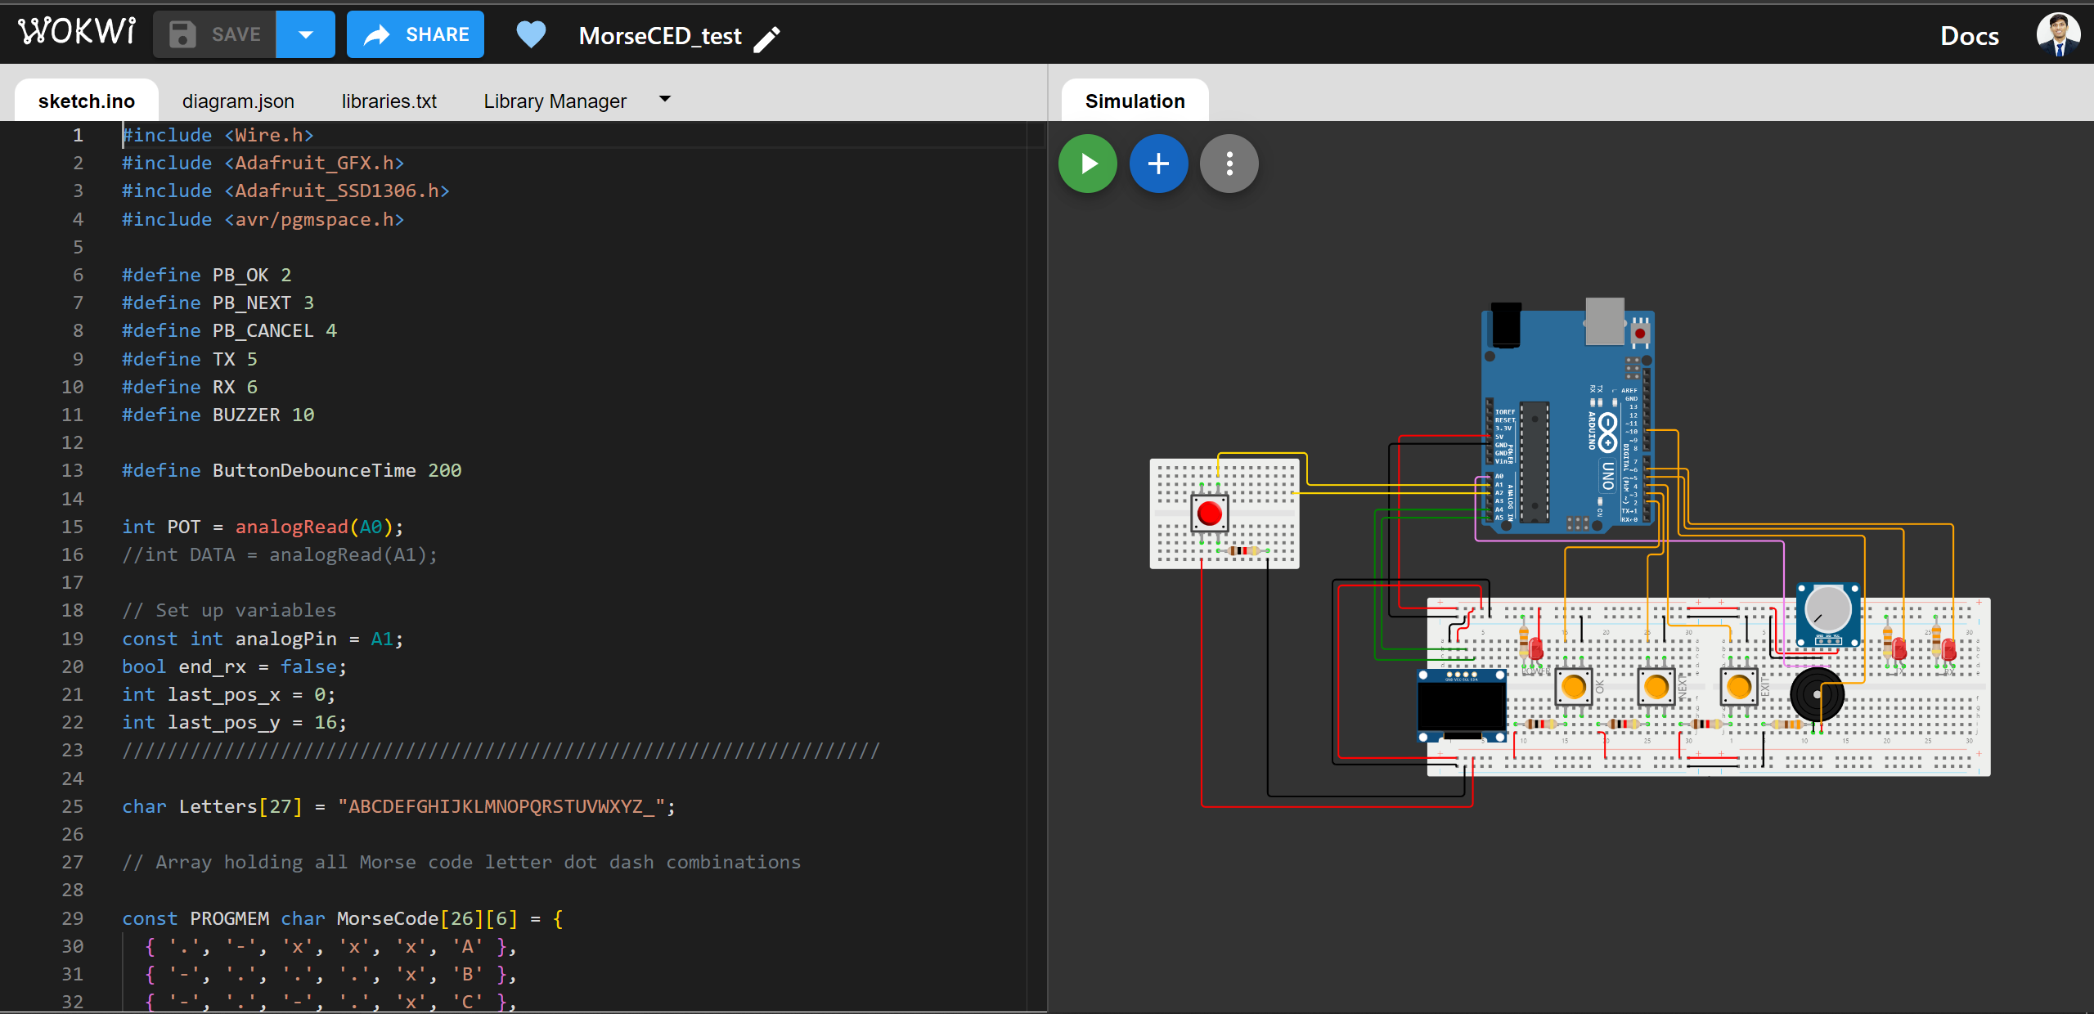
Simulation

Slide 5
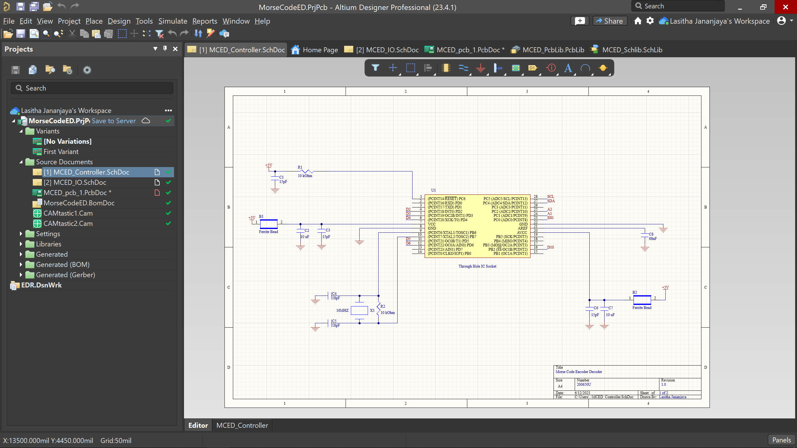
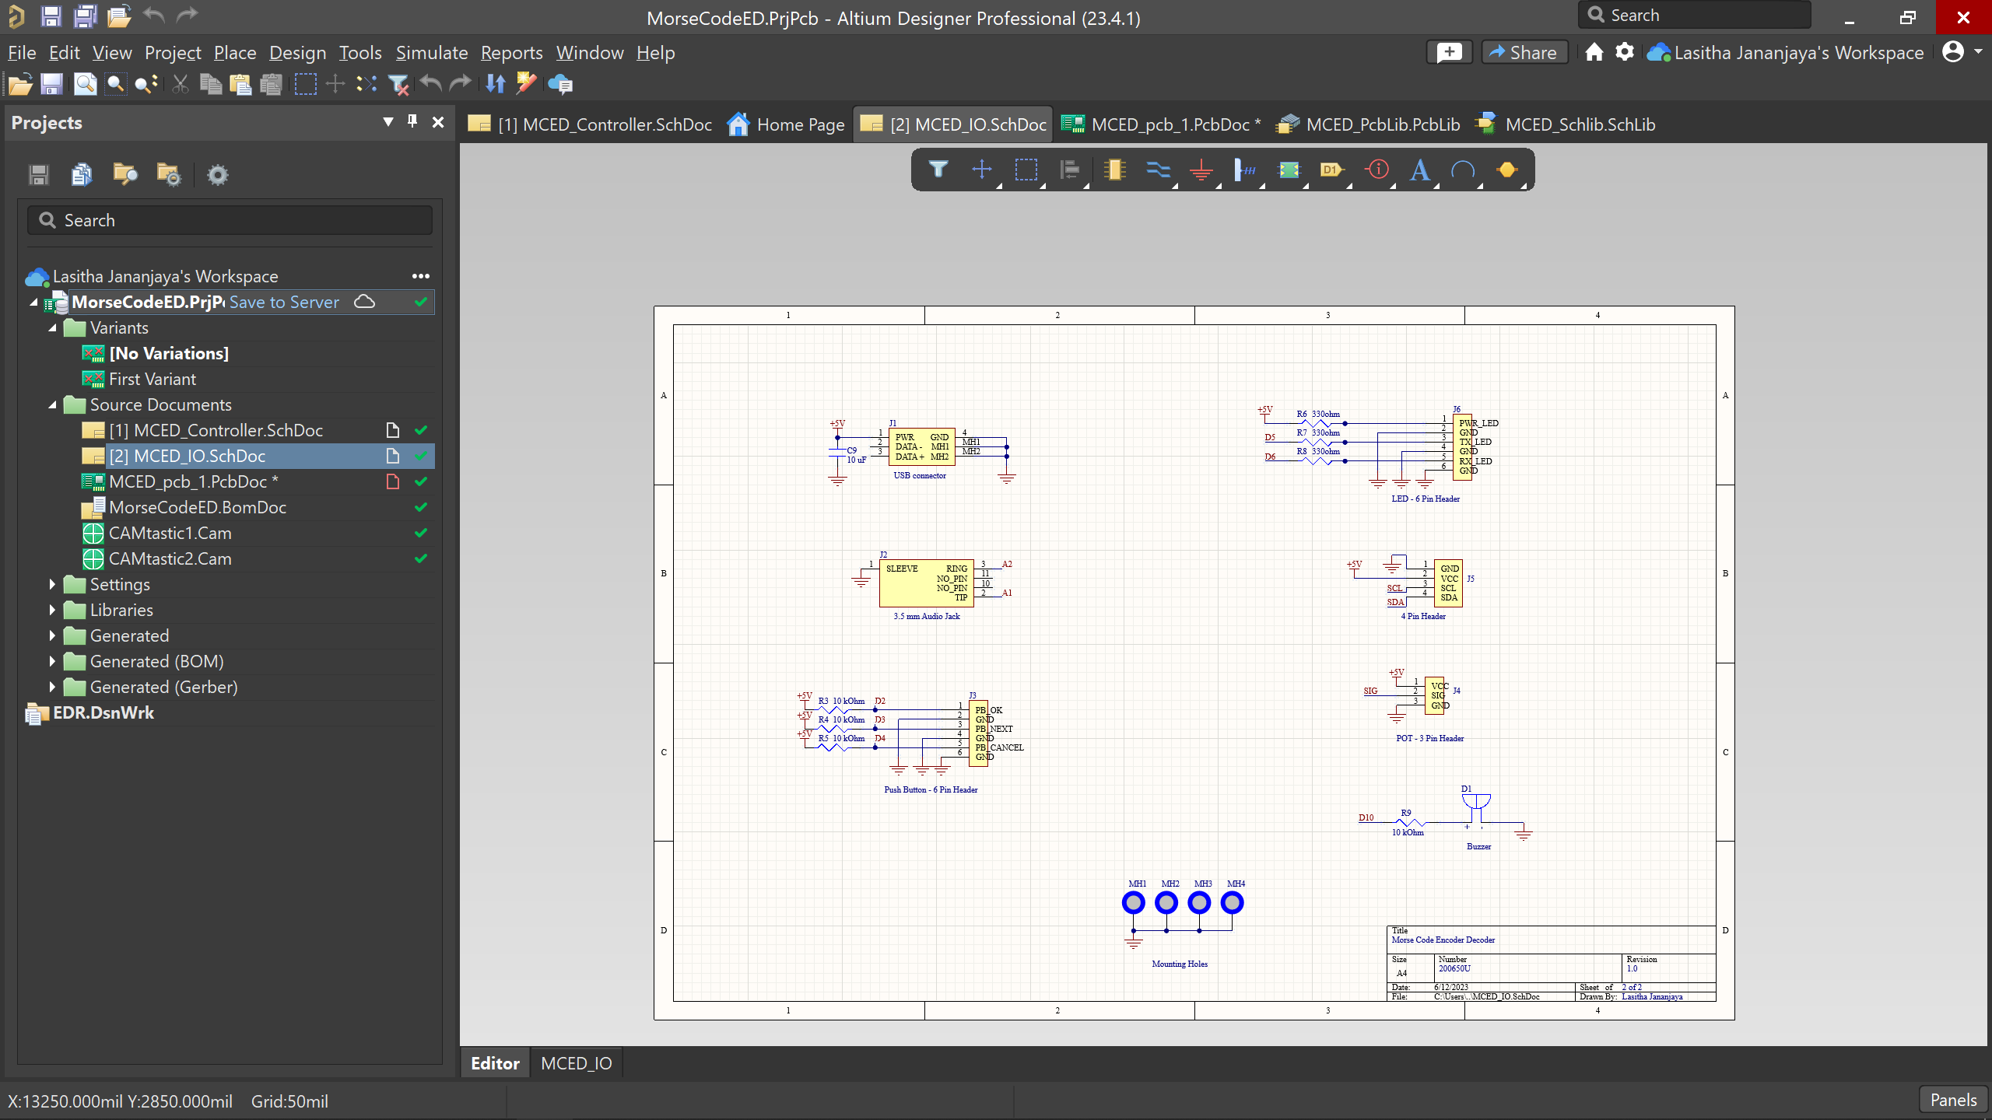
Schematic

Slide 6
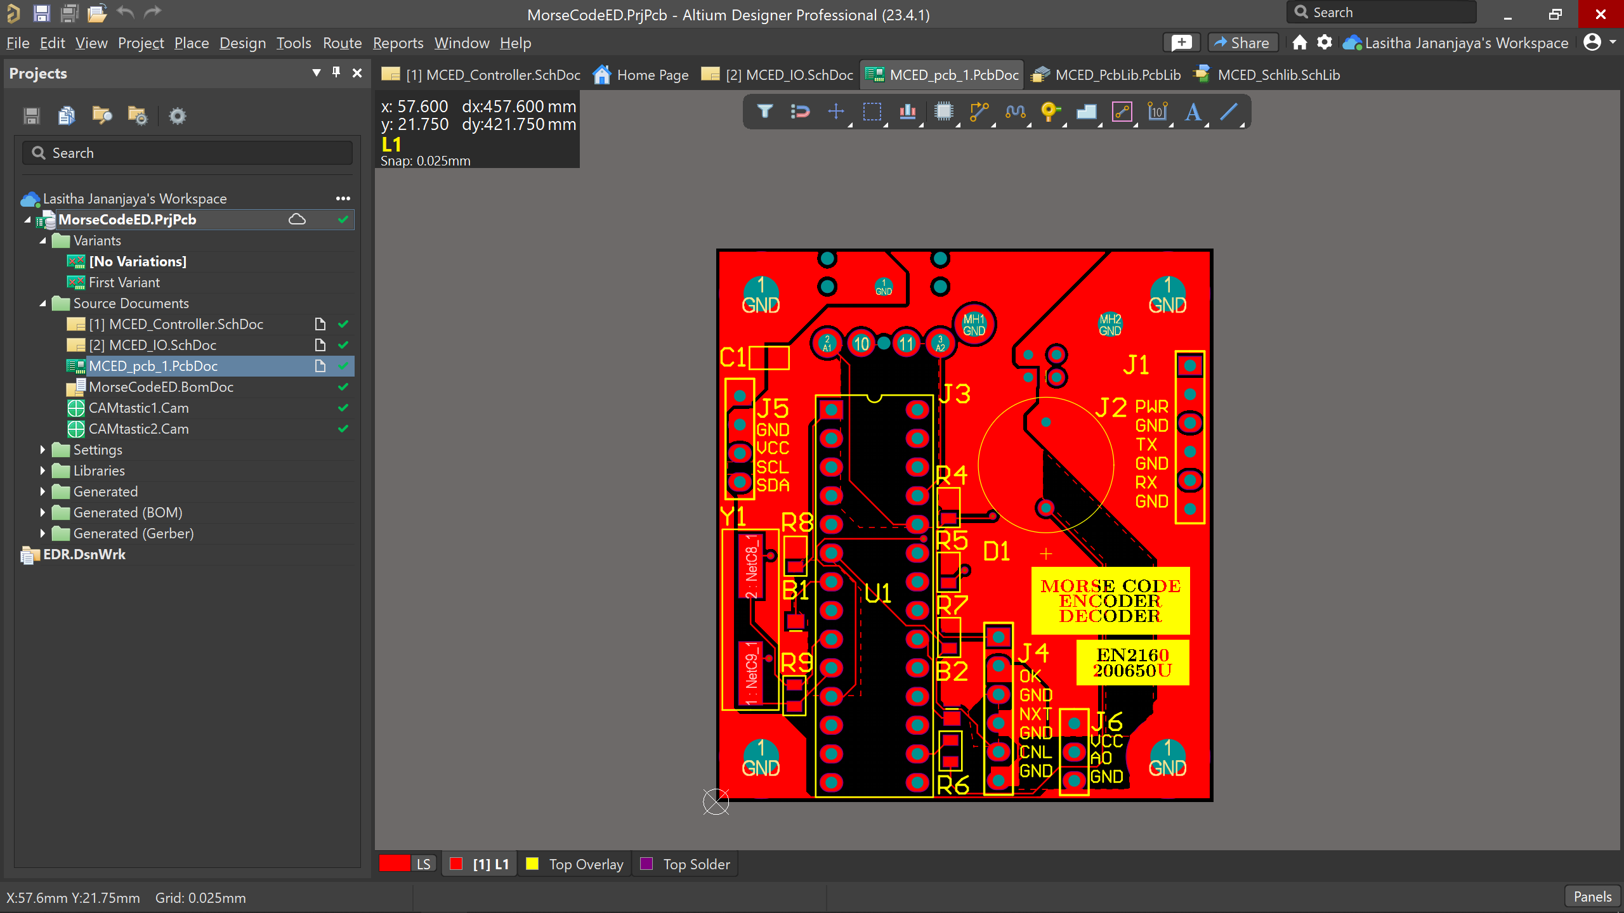
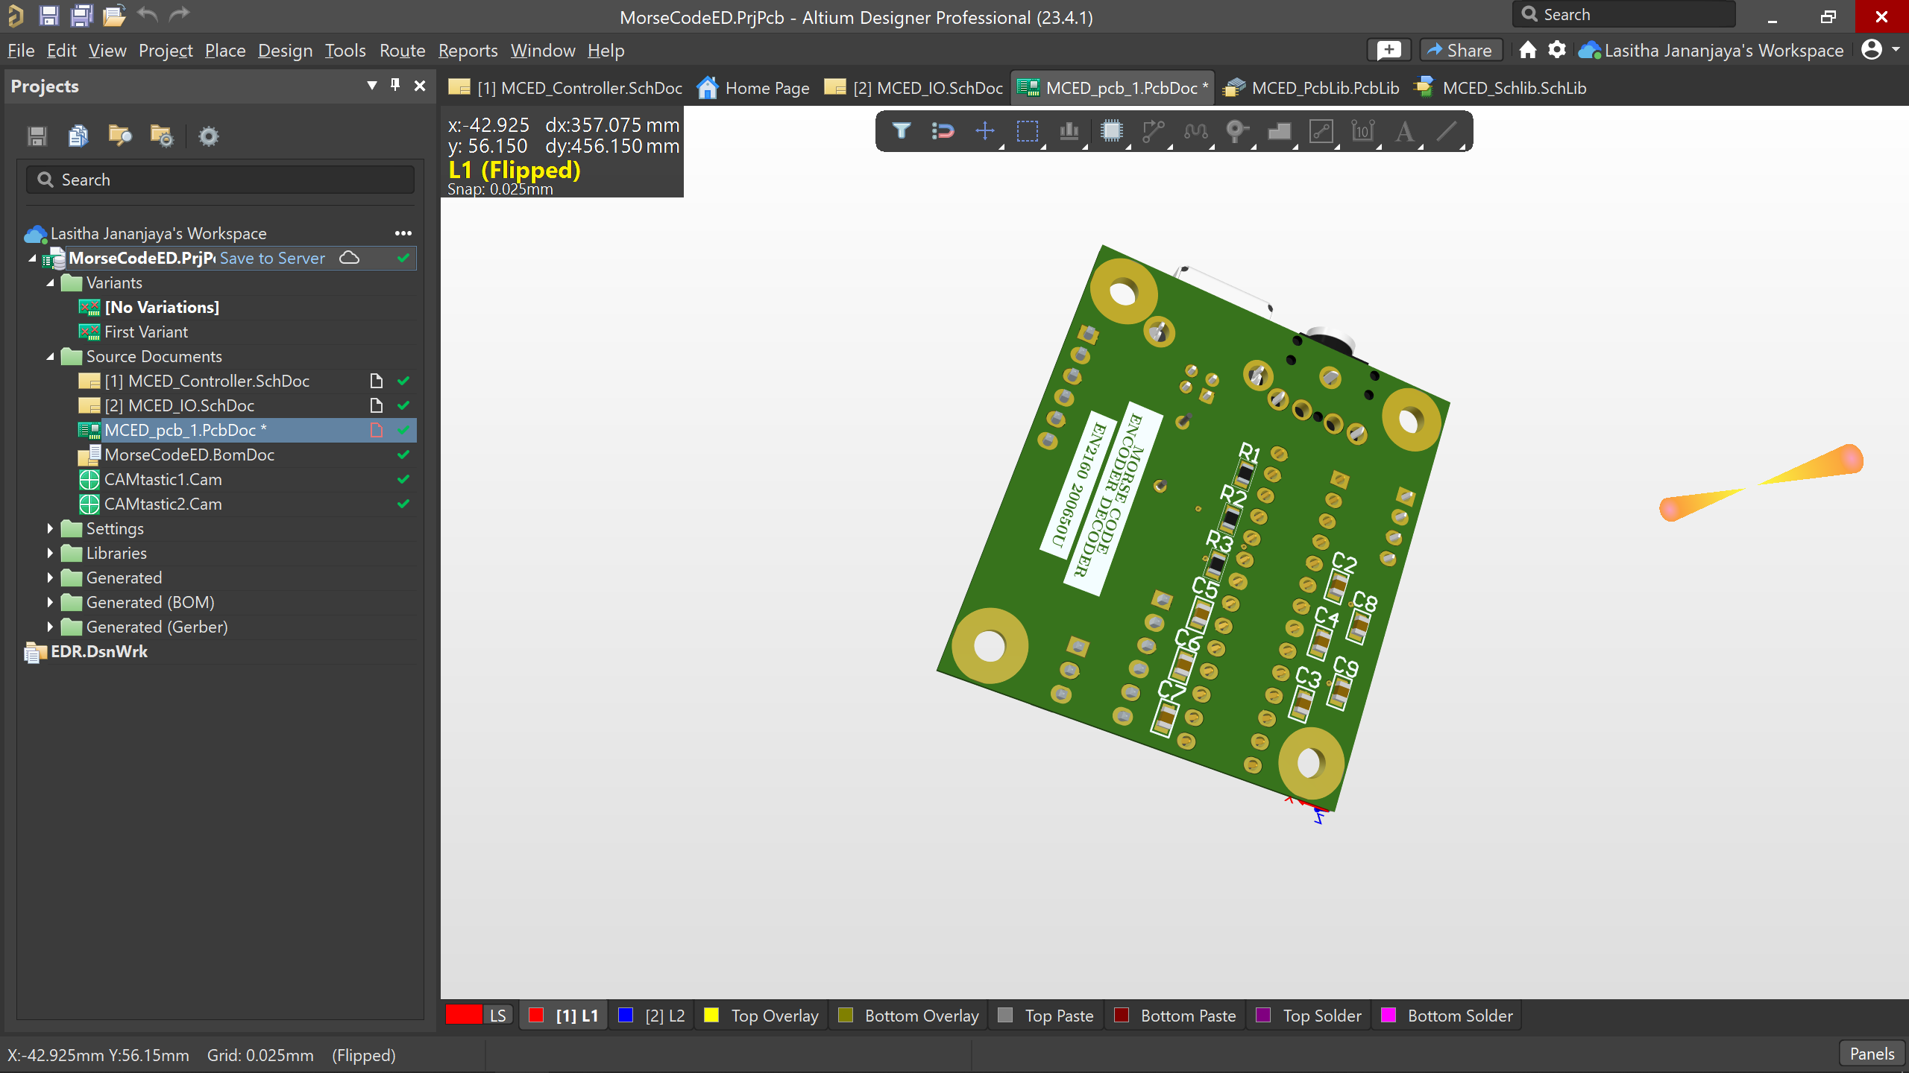
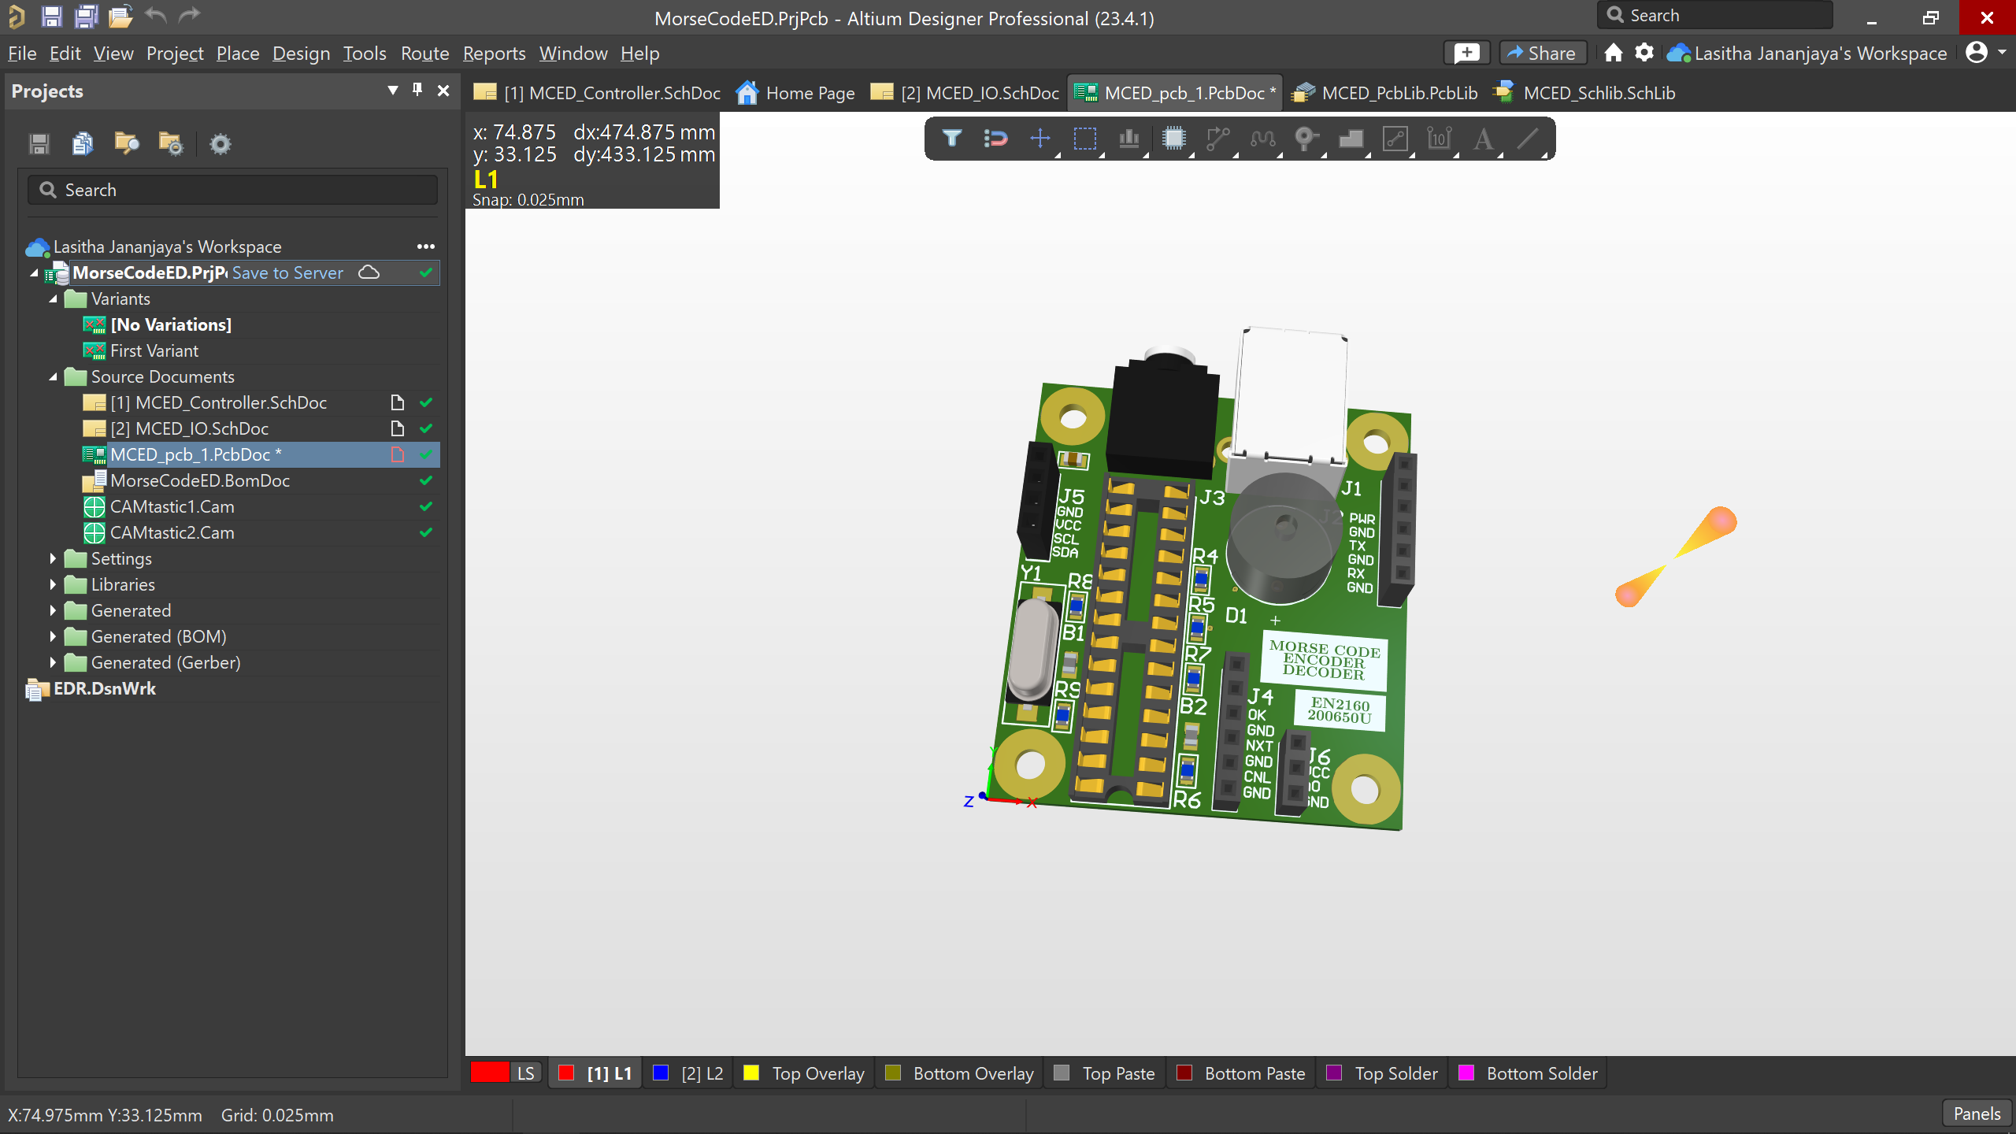
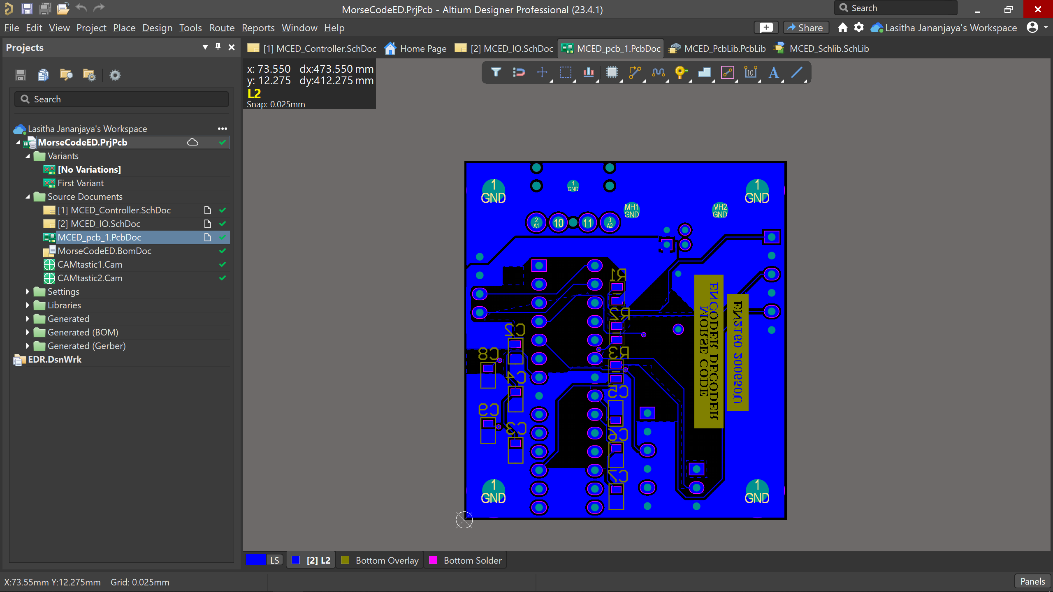
PCB design

Slide 7
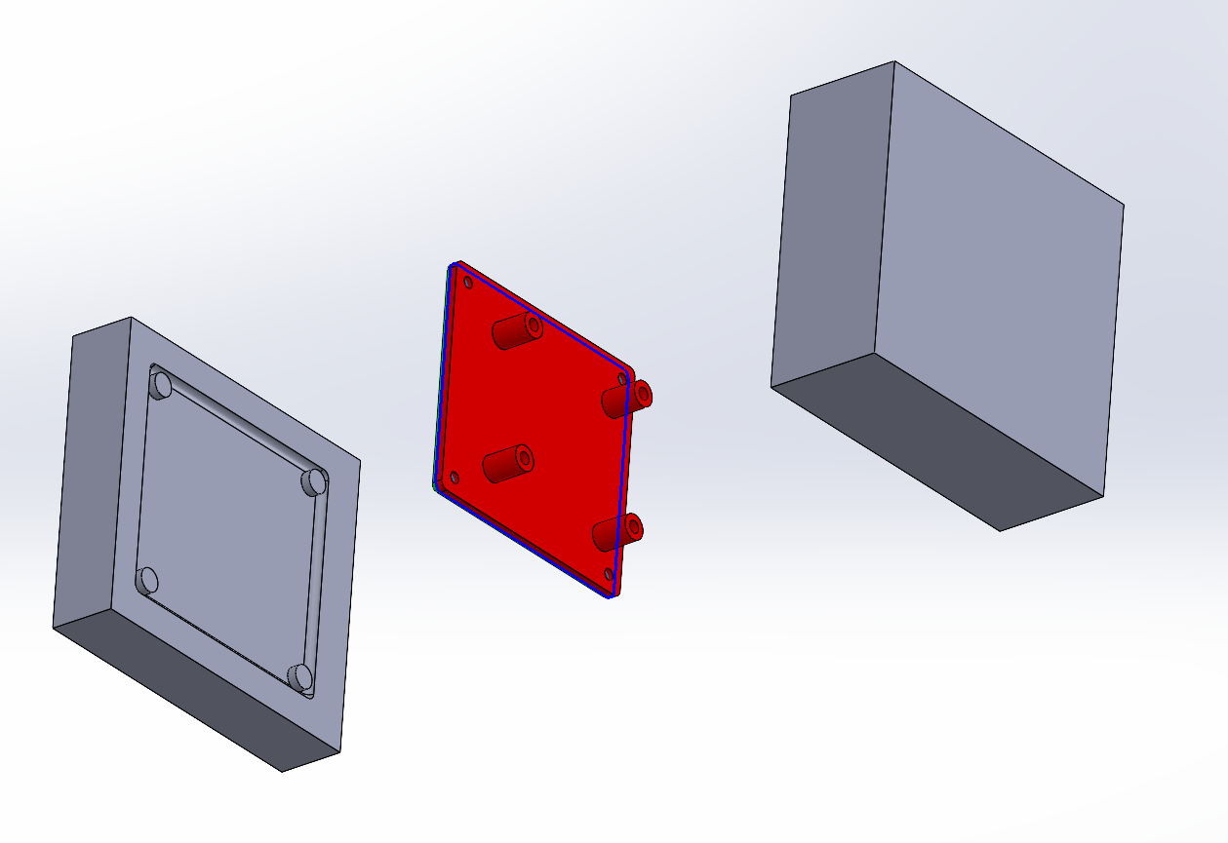
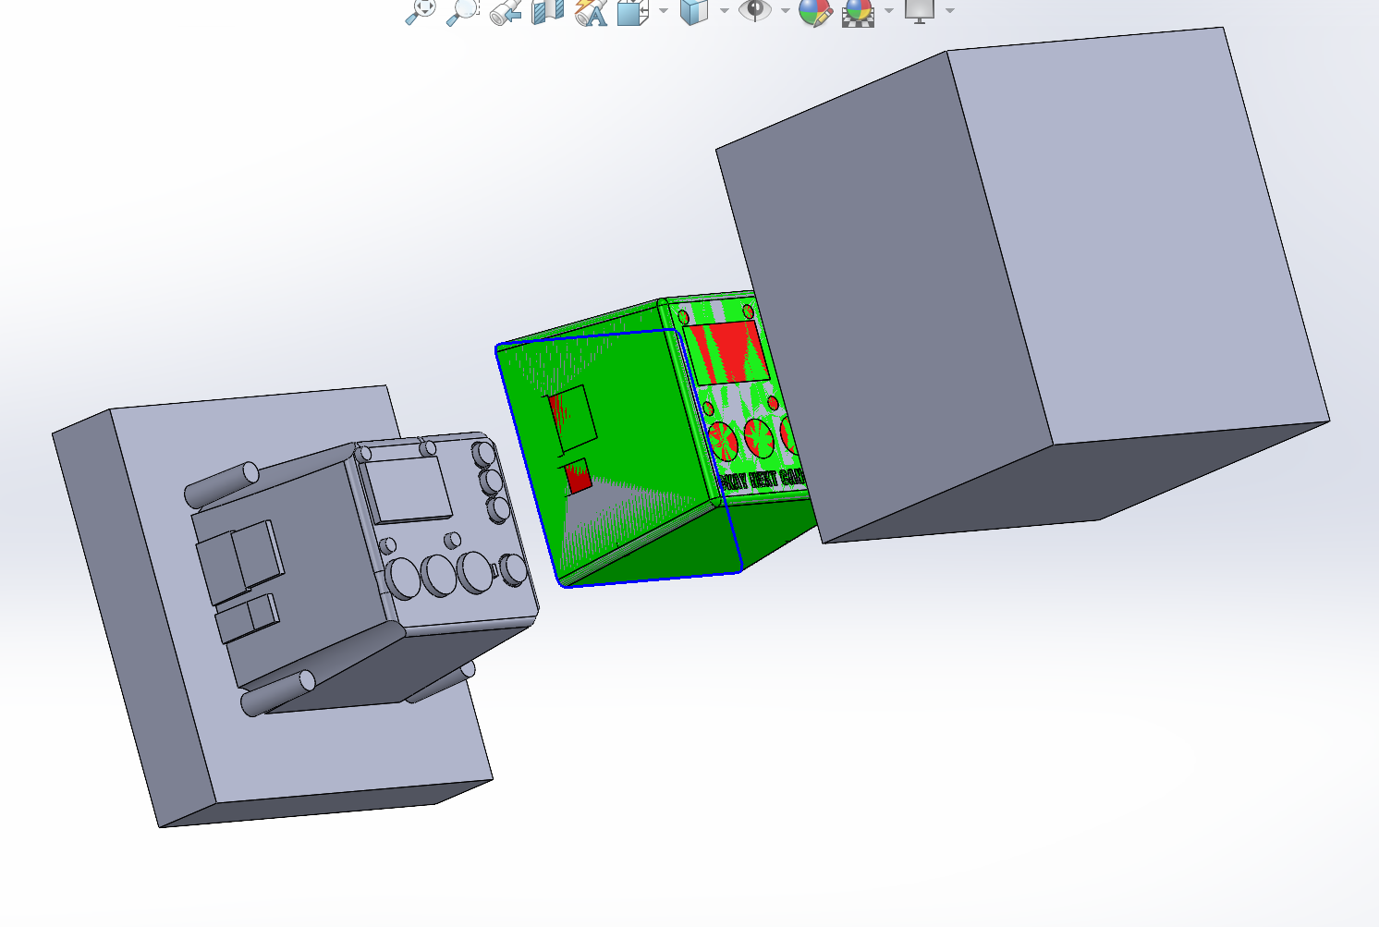
Enclosure

Slide 8
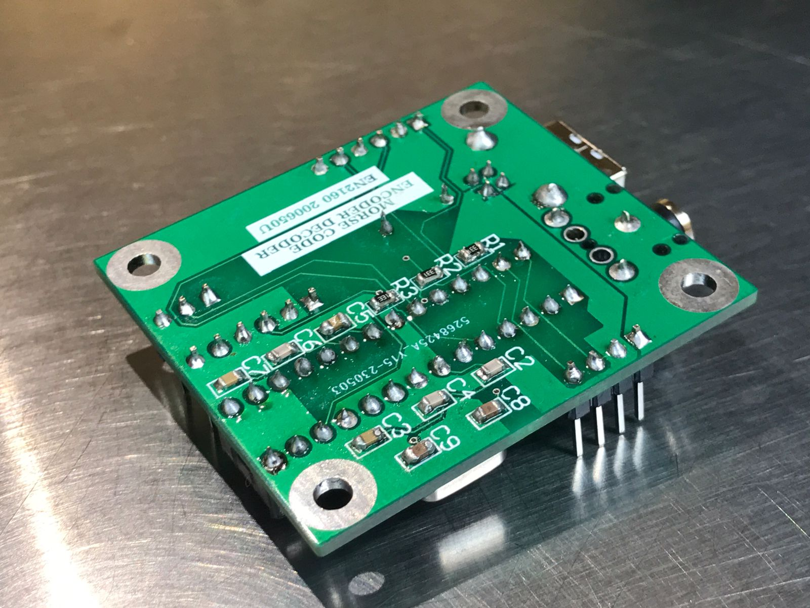
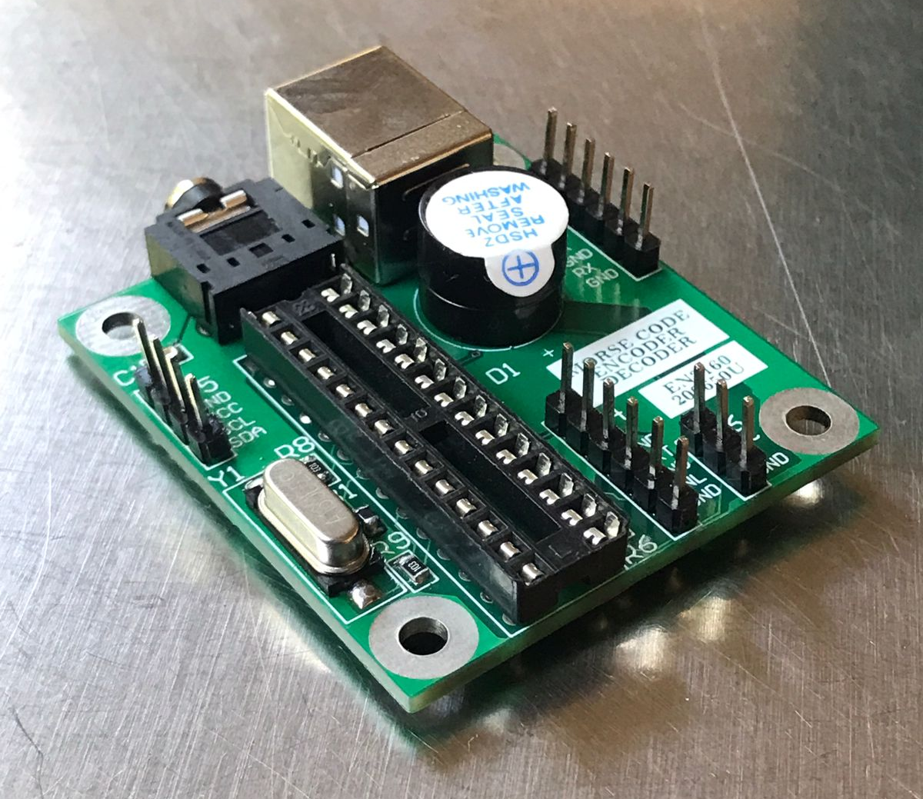
PCB Assembly

Slide 9
THANK YOU
200650U – Lasitha Jananjaya

Slide 10
Enclosure Assembly

Slide 11
SOLUTION
CLOSE THE GAP
TARGET AUDIENCE
Our product makes consumer lives easier, and no other product on the market offers the same features
Our target audience is Gen Z (18-25 years old)
COST SAVINGS
EASY TO USE
Reduce expenses for replacement products
Simple design that gives customers the targeted information they need

Slide 12
PRODUCT OVERVIEW
UNIQUE
Only product specifically dedicated to this niche market
FIRST TO MARKET
First beautifully designed product that's both stylish and functional
TESTED
Conducted testing with college students in the area
AUTHENTIC
Designed with the help and input of experts in the field

Slide 13
PRODUCT BENEFITS
Cool and stylish product
Areas for community connections
Online store and market swap

Slide 14
BUSINESS MODEL
ABSTRACT
We based our research on market trends and social media
DESIGN
We believe people need more products specifically dedicated to this niche market
RESEARCH
Minimalist and easy to use

Slide 15
MARKET OVERVIEW
$3 Billion
$1 Billion
$2 Billion
Freedom to invent
Selectively inclusive market
Serviceable available market
Opportunity to build
Fully inclusive market
Total addressable market
Few competitors
Specifically targeted market
Serviceable obtainable market

Slide 16
Market comparison
$3B
$2B
$1B
Opportunity to build
Freedom to invent
Few competitors
Addressable market
Serviceable market
Obtainable market

Slide 17
OUR COMPETITION
CONTOSO
COMPETITORS
Our product is priced below that of other companies on the market
Design is simple and easy to use, compared to the complex designs of the competitors
Affordability is the main draw for our consumers to our product
Company A Product is more expensive
Companies B & C Product is expensive and inconvenient to use
Companies D & E Product is affordable, but inconvenient to use

Slide 18
Our competition
Convenient
Contoso
Competitor A
Affordable
Expensive
Competitor D
Competitor C
Competitor B
Competitor E
Inconvenient

Slide 19
Growth strategy
Feb 20XX
Roll out product to high profile or top-level participants to help establish the product
Mar 20XX
Release the product to the general public and monitor press release and social media accounts
Oct 20XX
Gather feedback and adjust product design as necessary

Slide 20
TWO-YEAR ACTION PLAN
DRAFT BLUEPRINTS
GATHER FEEDBACK
DELIVER TO CLIENT
20XX
JAN
FEB
MAR
APR
MAY
JUN
JUL
AUG
SEP
OCT
NOV
DEC
20XX
JAN
FEB
MAR
APR
MAY
JUN
JUL
AUG
SEP
OCT
NOV
DEC
RUN FOCUS GROUPS
TEST DESIGN
LAUNCH DESIGN

Slide 21
FINANCIALS
 | Year 1 | Year 2 | Year 3
INCOME
Users | 50,000 | 400,000 | 1,600,000
Sales | 500,000 | 4,000,000 | 16,000,000
Average price per sale | 75 | 80 | 90
Revenue @ 15% | 5,625,000 | 48,000,000 | 216,000,000
GROSS PROFIT | 5,625,000 | 48,000,000 | 216,000,000
Expenses
Sales & marketing | 5,062,500 | 38,400,000 | 151,200,000 | 70%
Customer service | 1,687,500 | 9,600,000 | 21,600,000 | 10%
Product development | 562,500 | 2,400,000 | 10,800,000 | 5%
Research | 281,250 | 2,400,000 | 4,320,000 | 2%
TOTAL EXPENSES | 7,593,750 | 52,800,000 | 187,920,000

Slide 22
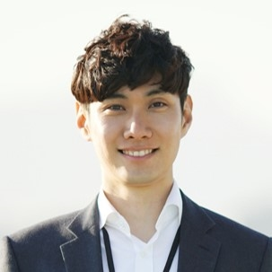
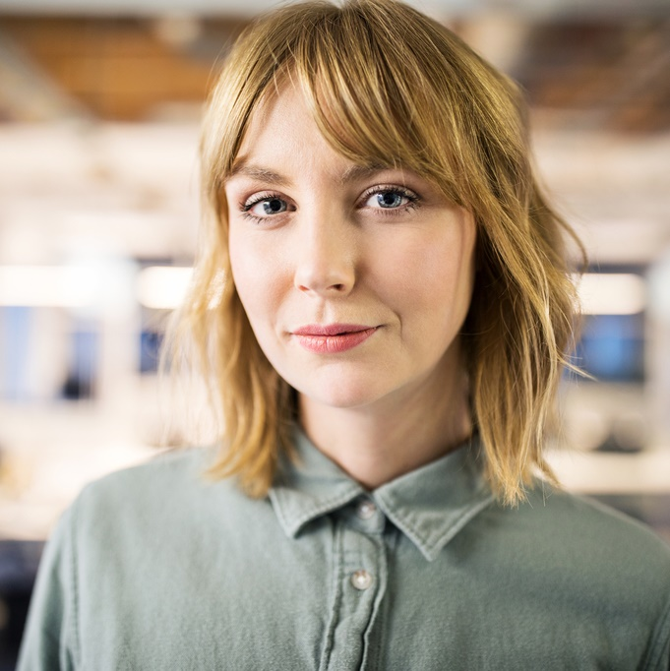


MEET THE TEAM
TAKUMA HAYASHI​
MIRJAM NILSSON​
FLORA BERGGREN​
RAJESH SANTOSHI​
President
Chief Executive Officer
Chief Operations Officer
VP Marketing

Slide 23
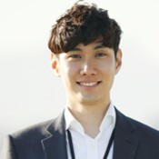

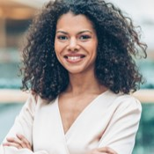

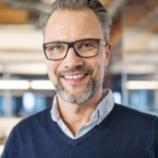
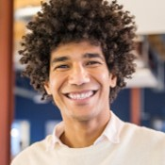


MEET THE TEAM
TAKUMA HAYASHI
MIRJAM NILSSON​
FLORA BERGGREN​
RAJESH SANTOSHI
President
Chief Executive Officer
Chief Operations Officer
VP Marketing
GRAHAM BARNES
ROWAN MURPHY
ELIZABETH MOORE
ROBIN KLINE
VP Product
SEO Strategist
Product Designer
Content Developer

Slide 24
SUMMARY
At Contoso, we believe in giving 110%. By using our next-generation data architecture, we help organizations virtually manage agile workflows. We thrive because of our market knowledge and great team behind our product. As our CEO says, "Efficiencies will come from proactively transforming how we do business.”

